Slide 1
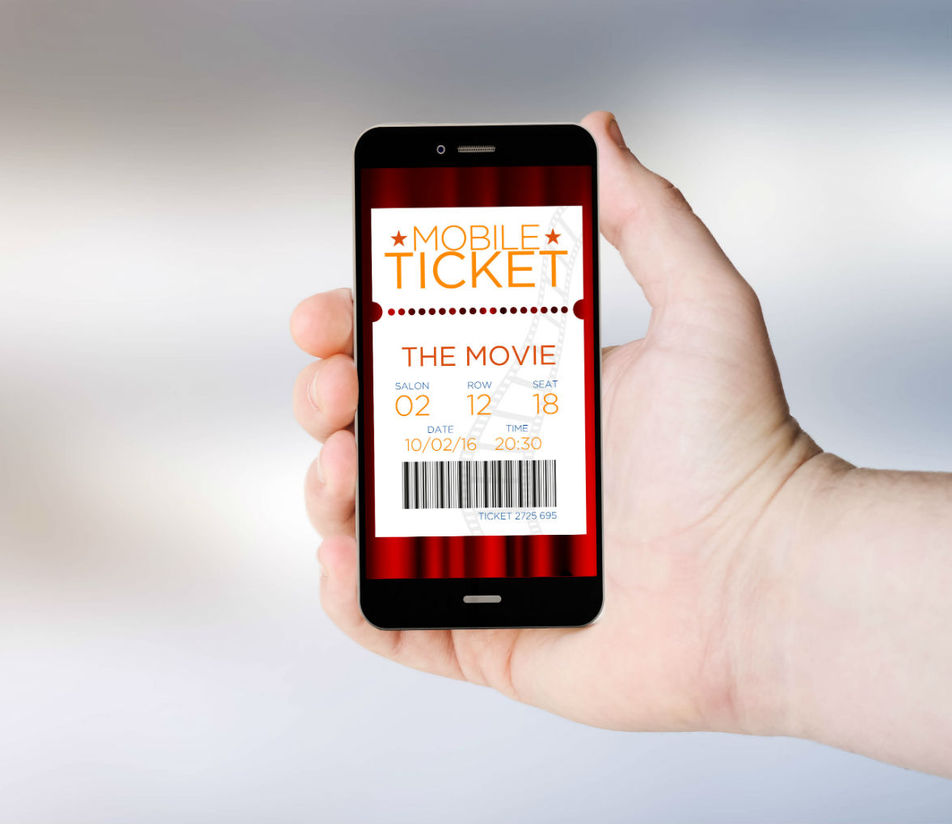
GROUP-1 . ONLINE MOVIE TICKET BOOKING system .
PRESENTED BY :
Chinta Jayasree (46294684)
Potnuru Ramya (46294683)
Chandrika Kumari Sasapu (46282518)
Rohini Gokake (46294642)
Mounika Palla(46294672)

Slide 2
CONTENTS
Introduction
Requirements
Problem statement
Functional specifications
Technical Specification
Flowchart
Modules
Hardware and software
UML Diagram
Tools
Benefits
conclusion

Slide 3
INTRODUCTION
Numerous people are constantly flooding movie theatres and cinemas for some entertainment daily. The excitement of these customers can be crushed however by the long lines involved in the manual process of booking and buying tickets. This is why many businesses are opting to invest in digital ways for customers to access their services.
An online movie ticketing system is a digital platform that allows customers to access the services of a business, reserve seats and buy tickets. This platform provides details such as what time a movie will be played, what seats are available, movie previews and so much more.

Slide 4
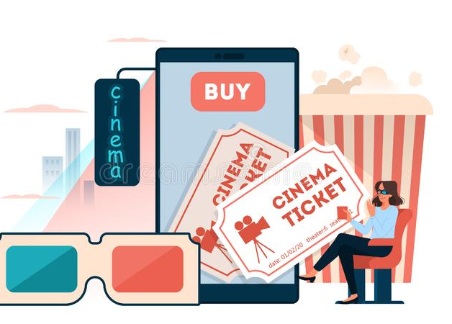
REQUIREMENTS
Problem Statement.
Functional Specifications.
Technical Specifications

Slide 5
PROBLEM STATEMENT
The main objective of “ONLINE MOVIE TICKET BOOKING SYSTEM” is to provide a convenient way to the users to book the tickets for cinema hall online, through which they can book tickets anytime and anywhere . Our application will also give the facility to let the user select any timing slot and they have the authority to choose any seat according to their convenience .
This application is basically made for providing customer an anytime and anywhere service for booking the seat in the cinema hall and to gather information about the movies online. The user can easily be able to know about the movies released and then make the choices .

Slide 6
FUNCTIONAL SPECIFICATIONS
Register:
System will allow users to create account.
Login :
System will allow the user to login.
System will verify the username and password.
System will not allow user to login with invalid username or password.
System will be able to remember username and password
Browsing and data base search:
System will allow user to search movies that are available from movie list
System shall display the movie list.
System will allow the user to select the movie and then he can book the ticket on the bases of his requirements like seats, show time , deluxe , normal ..

Slide 7
Send Ticket- After successful payment, user get ticket with seat number and other essential information.
Cancel Ticket -In some situations, if user want to cancel the ticket then user cancel his ticket on the bases of ticket number which was provide on the time of ticket booking.

Slide 8
TECHNICAL SPECFICATION
Every online booking needs to be associated with an account.
One account cannot be associated with multiple users.
Search results should enable users to find the most recent and relevant booking options.
System should enable users to book / pay for their tickets only in a timeboxed manner after tickets being added to the cart.
System should only allow users to move to payment only when the seats are booked in particular row and column.

Slide 9
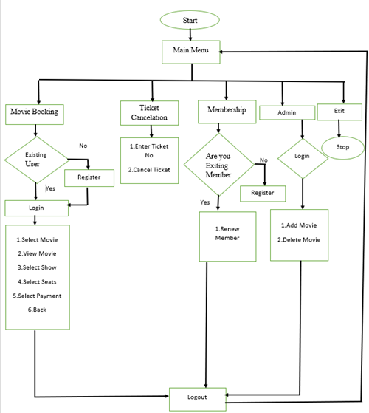
FLOW CHART

Slide 10
MODULES
Admin module: The Admin will use this module. Admin will get access to the system only after the login and based on the login ID they will get options in the system. Admin add and delete the movies in the list. Movie booking module: The customer will use this module, and through this module, the users can search for a movie, can pay. Membership module: This module will give information about the membership of a member. This system will provide membership extension for 1year, 3 years and 5 years.
Ticket cancellation module: By use of this module a customer can cancel the tickets and will request the refund.

Slide 11
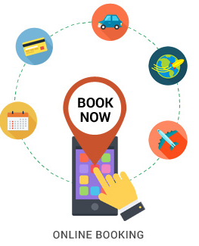
HARDWARE AND SOFTWARE
C++ language
Ubuntu/Linux terminal
System with i3 processor

Slide 12
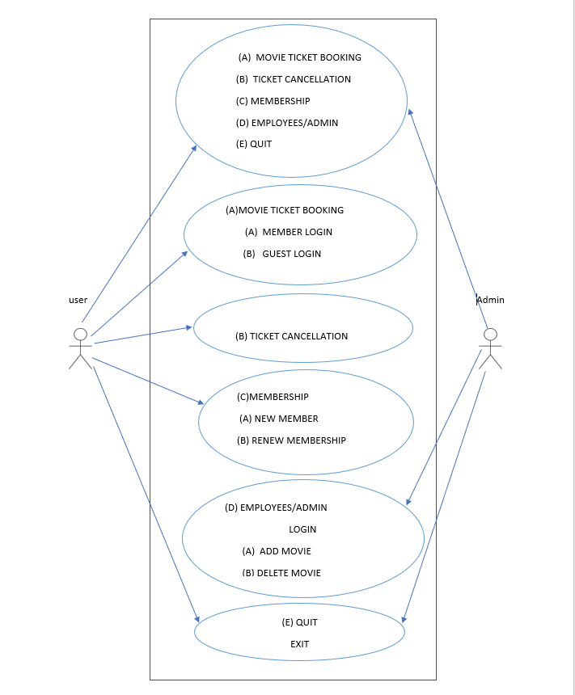
UML DIAGRAMS
Use case diagram:

Slide 13
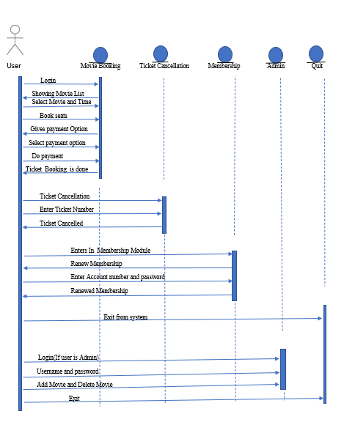
Sequence diagram:

Slide 14
Tools
VALGRIND:
It is memory checking tool to detect memory leaks and it majorly focus on dynamic memory.
SPLINT:
Static analyzer which helps programmer in finding possible errors in program without having to compile or executing the program.
MAKEFILE:
Tool used for run and compile program automatically in more efficient way.
C++/CPP Unit testing:
Unit testing is used to test a particular code or for to a particular function .
IT testing:
IT testing is used to test for enter code after the integration is done

Slide 15
BENEFITS
Customer Satisfaction - Provide customers with the very best services and to meet all their needs.
Reduce Costs - A major benefit of the digital era is the way it can drastically cut costs.
User Friendly - Most software developers use it because it is not complicated to use. They make the user experience enjoyable and even the admins have an easy time updating the system.
Analytics - Data collected digitally is fairly easy to analyze. Customers can also give their feedback concerning the services which the business can take into consideration.

Slide 16
LIMITATIONS
You need internet access.
You need to be ready for an influx of new customers.
Not all online booking systems are created equal.
Avoid booking systems that don’t bring you new quality customers.

Slide 17
CONCLUSION
The project Movie ticket booking System, provides the customer with hassle-free service for booking movie tickets online and avoids standing in a long queue and provides the customers facility to book tickets for movie online and gather information about the movies and its timings.
The web-based application can help customer to book ticket for movie from any device which is connected to internet, the web-based application will make customers to watch trails, movie rating, and book tickets, pay from their debit cards easily.
This application will keep the record of customers, customer will always be able to book and check new movies in list.

Slide 18


